Slide 1
Principles of Justice

Slide 2
Learning Intention
To investigate the principles of Justice
Success Criteria
I can explain the meaning of …
Equal access to justice
Equality before the law
Independent judiciary
Rights of appeal
Presumption of Innocence
Other rights in criminal cases

Slide 3
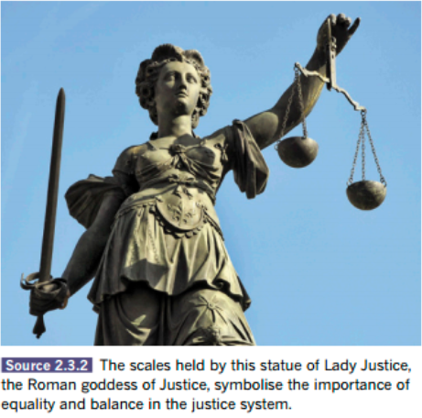
Symbolism
What type of ideas are associated with this image?
When was this image first created and in what other nations is it used?
Consider the symbols that are involved, including the way Lady Justice is dressed and the items she is holding.
How are these relevant to the Australian court system?
Notes:
Teacher notes:
Lady Justice is a well-known symbol of the justice system. The modern image of Justice is based on Greco-Roman mythology of Themis and Justitia. Almost always draped in flowing robes, mature but not old, she symbolizes the fair and equal administration of the law, without corruption, avarice, prejudice, or favour.
She holds a sword to represent her power and authority, and scales, which represent the weighing of evidence on its own merit.
Sometimes she is shown with a blindfold to represent that justice is blind to a person's wealth, power, gender and race (everyone is equal before the law).
This is relevant to Australia today as they symbolise the importance of justice to Australian society.
Sourced from: https://itsaboutjustice.com/symbol-justice/

Slide 4
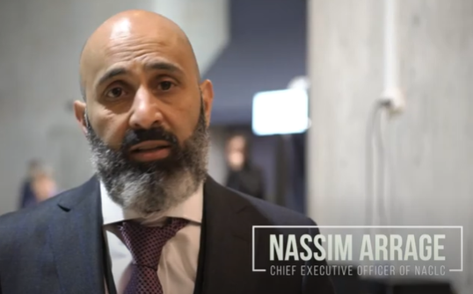

Why is Access to Justice Important?
Notes:
YouTube - Community Legal Centres NSW - Why is access to justice important?
https://www.youtube.com/watch?v=PHwP0LJCcGw
2 minutes 43 secs

Slide 5
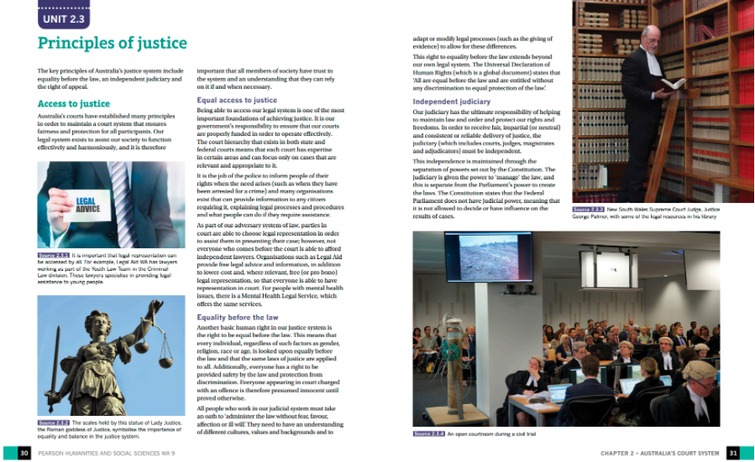
Read
Access to Justice - page 30

Slide 6

Complete the following tasks:
5 minute
Task
Explain the importance of the Australian legal system.
Illustrate one way in which equal access to justice is achieved in Australia.
Notes:
Teacher notes - suggested answers:
The legal system is essential to ensure that Australian society functions effectively. It offers protection and fairness for those who participate in the courts.
One way to ensure equal access to justice in Australia is through the ability to choose your legal representatives and to make your own decisions about how to present your case to the court.

Slide 7
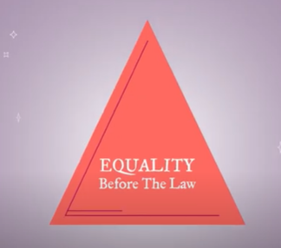
Equality Before the Law
Notes:
YouTube – Australian Human Rights Commission - Rights & Freedoms and the Courts
https://www.youtube.com/watch?v=wZMvQPVL_rY
1 minute 30 secs

Slide 8
Read
Equality before the law - pages 30 - 31

Slide 9
Complete the following task:
3 minute
Task
3. Rewrite what is meant by the idea of equality before the law.
Notes:
Teacher notes - suggested answer:
3. Equality before the law means that all individuals are treated equally by the legal system, irrespective of their background. All people should have the same rights before the law, as the law must be applied equally to everyone.

Slide 10

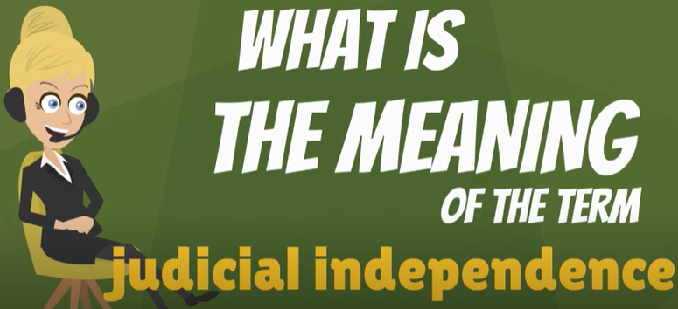
Separation of Powers & Independent Judiciary
Notes:
YouTube – Separation of Powers explained
https://www.youtube.com/watch?v=e1cN5KuB5s0
2 minutes 9 secs
YouTube - What is JUDICIAL INDEPENDENCE? What does JUDICIAL INDEPENDENCE mean?
https://www.youtube.com/watch?v=cJFzjEUH7os
1 minute 37 secs

Slide 11
Read
Independent judiciary - pages 31 and 32

Slide 12
Complete the following task:
3 minute
Task
4. Summarise the methods used to ensure that the judiciary remains independent.
Notes:
Teacher notes - suggested answer:
4. The independence of the judiciary is established by ensuring that judges are given powers to manage the law separate to parliament’s ability to create the law. In addition, judges cannot be removed from their roles by parliament without good reason (i.e. misconduct, incapacity).

Slide 13
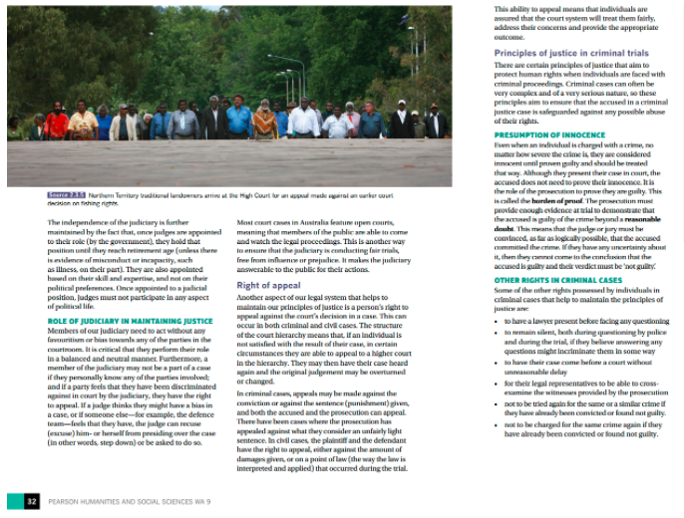
Read
Role of Judiciary, Presumption of Innocence & Other Rights pages 32 and 33

Slide 14
Complete the following task:
3 minute
Task
5. Now that you have read through Unit 2.3, The Principles of Justice, name three principles of justice that are applied in Australia.
Notes:
Teacher notes - suggested answer:
Three principles of justice in Australia are:
equality before the law;
the right of appeal; and
the existence of an independent judiciary.

Slide 15
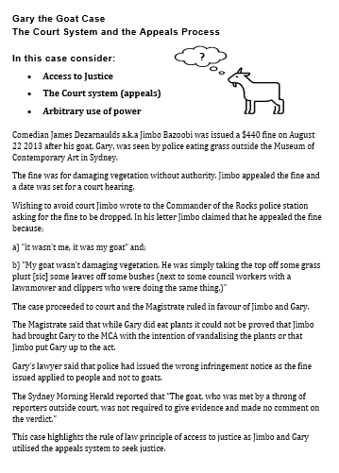
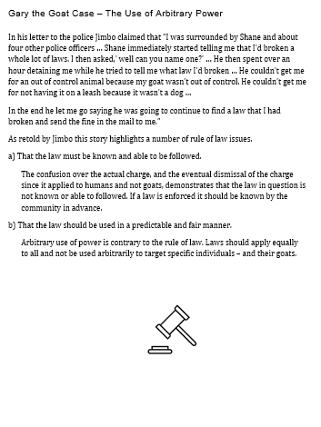
Gary the Goat Case
Read:
Watch: Gary the Goat has his day in court
Notes:
YouTube: Gary the Australian goat has charges dropped against him
https://www.youtube.com/watch?v=Bdy9TPOPhBo
1 minute 45 seconds

Slide 16
Gary the Goat Case
Discussion Questions:
1. What non-legal measures did Jimbo take in an effort to have the fine dropped?
2. What legal measures did Jimbo take to have the fine dropped?
3. Did you know it was illegal to destroy flowers?
4. How should police enforce laws that are not known by the community?
5. What steps could be taken to publicise laws that are not well known?
6. What issues arise from using laws in an arbitrary manner?
Notes:
Teacher notes:
Jimbo wrote to the Commander of the Rocks Police Station
Jimbo appealed the fine imposed by the Police by taking the case to the Magistrates Court
The legal position is that all plants and trees belong to the owner of the property. If the plants and trees are on a common pathway, they are on Council land. Therefore, the bottom line is that unless the property is owned by you, it is against the law to remove anything from the property unless you have permission from the owner. However, if part of a plant or tree in your neighbour’s property overhangs into your property, you have the right to remove the overhanging part. The cost of having it removed is to be met by you, unless your neighbour agrees to pay for the removal. Source: https://www.hutchinsonlegal.com.au/picking-flowers/
Although there’s absolutely no way which any normal person would be aware of every law, ignorance of the law still is not an excuse if a person commits a crime. Source: https://www.findlaw.com.au/articles/5785/is-ignorance-of-the-law-a-defence-in-relation-to-c.aspx#:~:text=Ignorance%20of%20an%20offence%20is%20not%20a%20defence&text=%E2%80%9CProfessor%20Glanville%20Williams%20said%20that,presumed%20to%20know%20the%20law.
Students should develop their own response
Students should develop their own response but could consider the impact on the public, policing and courts.

Slide 17
Success Criteria
I can explain the meaning of …
Equal access to justice
Equality before the law
Independent judiciary
Rights of appeal
Presumption of Innocence
Other rights in criminal cases

